Slide 1
PRESENTATION
ON
FORECASTING
SUBMITTED BY- SUBMITTED TO-
Prashant Singh Prof. S.K Sharma
18102005

Slide 2
Annual Canadian Lynx trappings 1821–1934
Annual numbers of lynx trappings for 1821–1934 in Canada. Taken from Brockwell & Davis (1991)
TOTAL NO OF OBSERVATIONS=114

Slide 3
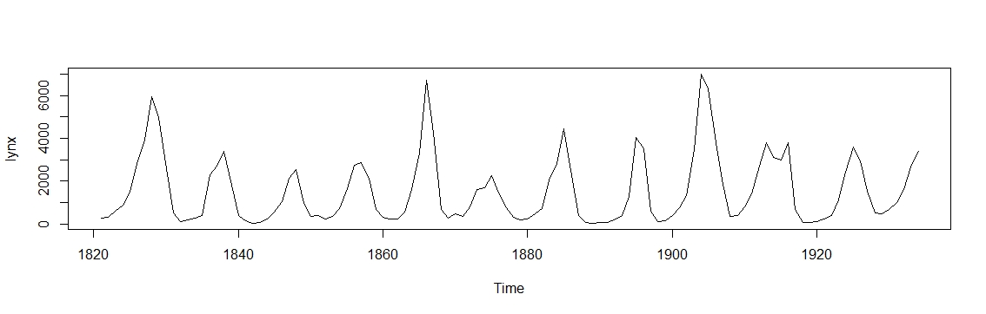
TIME SERIES PLOT

Slide 4
IMPORTANT POINTS
No trend
Cyclic pattern
No seasonality(coz no fixed interval)
An autoregressive dataset (lynx caught in the prior year influence the number of lynx caught in the next year).

Slide 5

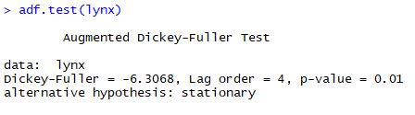
CHECK FOR STATIONARITY
As our data set is stationary, we don’t need any differencing

Slide 6

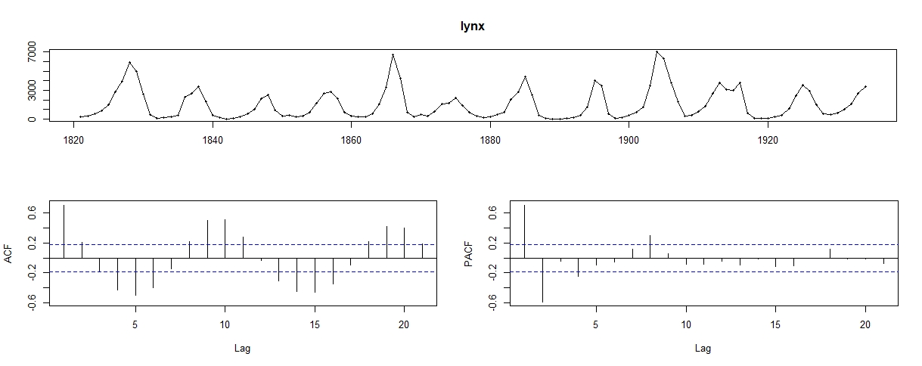
ACF and PACF PLOTS

Slide 7
IMPORTANT POINTS
ACF plot shows autocorrelation in the data set which needs to be covered by the model.
The PACF plot suggests that this model will be atleast an AR(2) model. It could even be higher and could also contain MA part.

Slide 8
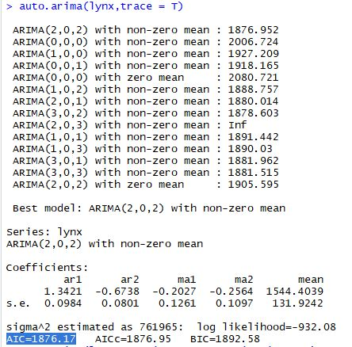
POSSIBLE ARIMA MODELS
auto.arema(lynx,trace=T)

Slide 9
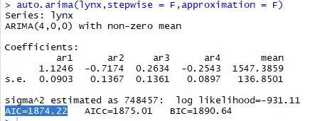
OTHER POSSIBLE ARINA MODEL
auto.arima(lynx,stepwise = F,approximation = F)
SO THE BEST MODEL IS ARIMA (4,0,0)

Slide 10
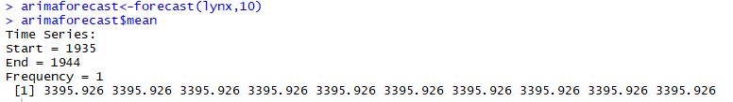
FORECASTING USING ARIMA
arimaforecast<-forecast(lynx,10)
arimaforecast$mean

Slide 11
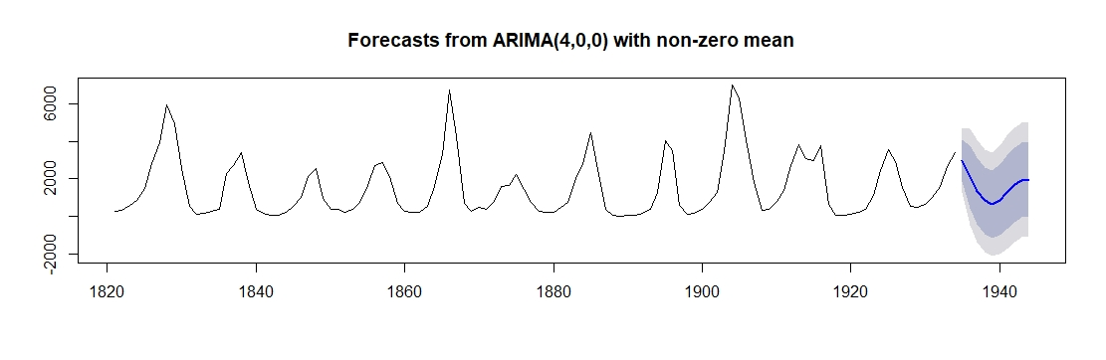
FORECAST PLOT
myarima<-auto.arima(lynx,stepwise = F,approximation = F)
aremafore<-forecast(myarima,h=10)
plot(aremafore)

Slide 12
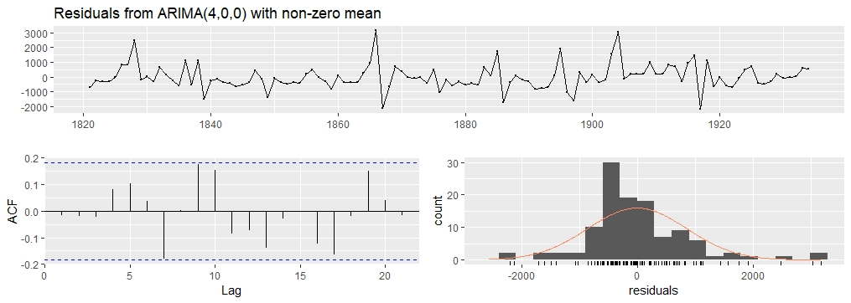
CHECKING RESIDUALS
checkresiduals(aremafore)

Slide 13
RESULTS
Looking at the residual plot we can conclude that the residuals are random in nature. There is no significant pattern.
We can see from the ACF plot that there is no line crossing the limits. So we can say that the model is quite good enough to capture all the significant variation in the data.
Also the residuals are approximately randomly distributed which also indicates that our fitted model is good.

